Slide 1





IIT
Kanban Board

Slide 2

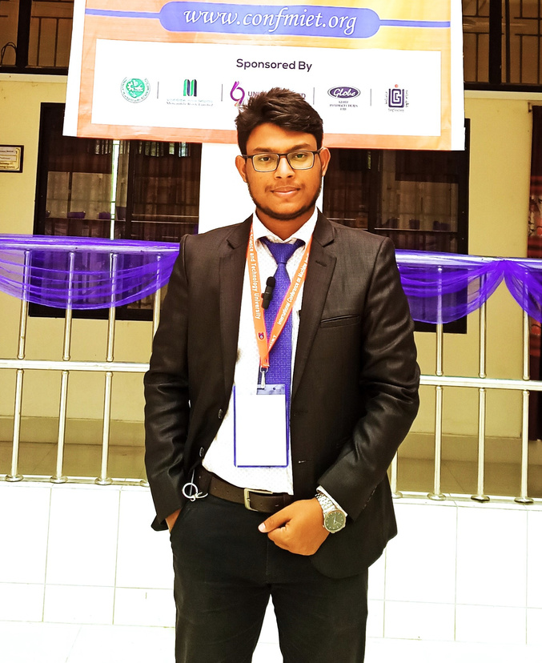




Project member
Md Raju Mia
Md Zahid hasan
MHH2025016M
ASH2025012M
Israt Jahan Jhumu
Md. Saiful Islam
BKH2025020F
MUH2025033M
07 September, 2023 page 02

Slide 3



Table of Content
Objective
Motivation
Stakeholder
Use Case Diagram
ER Diagram
Database Schema
07 September, 2023 page 03

Slide 4


Objectives
The primary objective of the "IIT Kanban Board Software Project" is to revolutionize project management and collaboration within the IIT community. Through the development of a digital platform, this project aims to provide teachers and students with efficient tools for planning, tracking, and managing their academic and research projects. By achieving these the project aspires to usher in a new era of digital project management at IIT, ultimately leading to improved project outcomes and more effective academic and research endeavors.
07 September, 2023 page 04

Slide 5



Motivation
In IIT we have done each of our SPL through analog process in previous time. There is no well furnished technological platform to understand the improvement of our own work. But in recent time there are numerous developed software for overlooking the improvement of our work, communicating with each others and sharing documents etc. But these resources are not free of cost. So we want to develop a project that aims for enriching our technological knowledge and leads IIT to forward.
07 September, 2023 page 05

Slide 6




Stakeholders
Project Member
Supervisor
Administrator
System
07 September, 2023 page 06

Slide 7
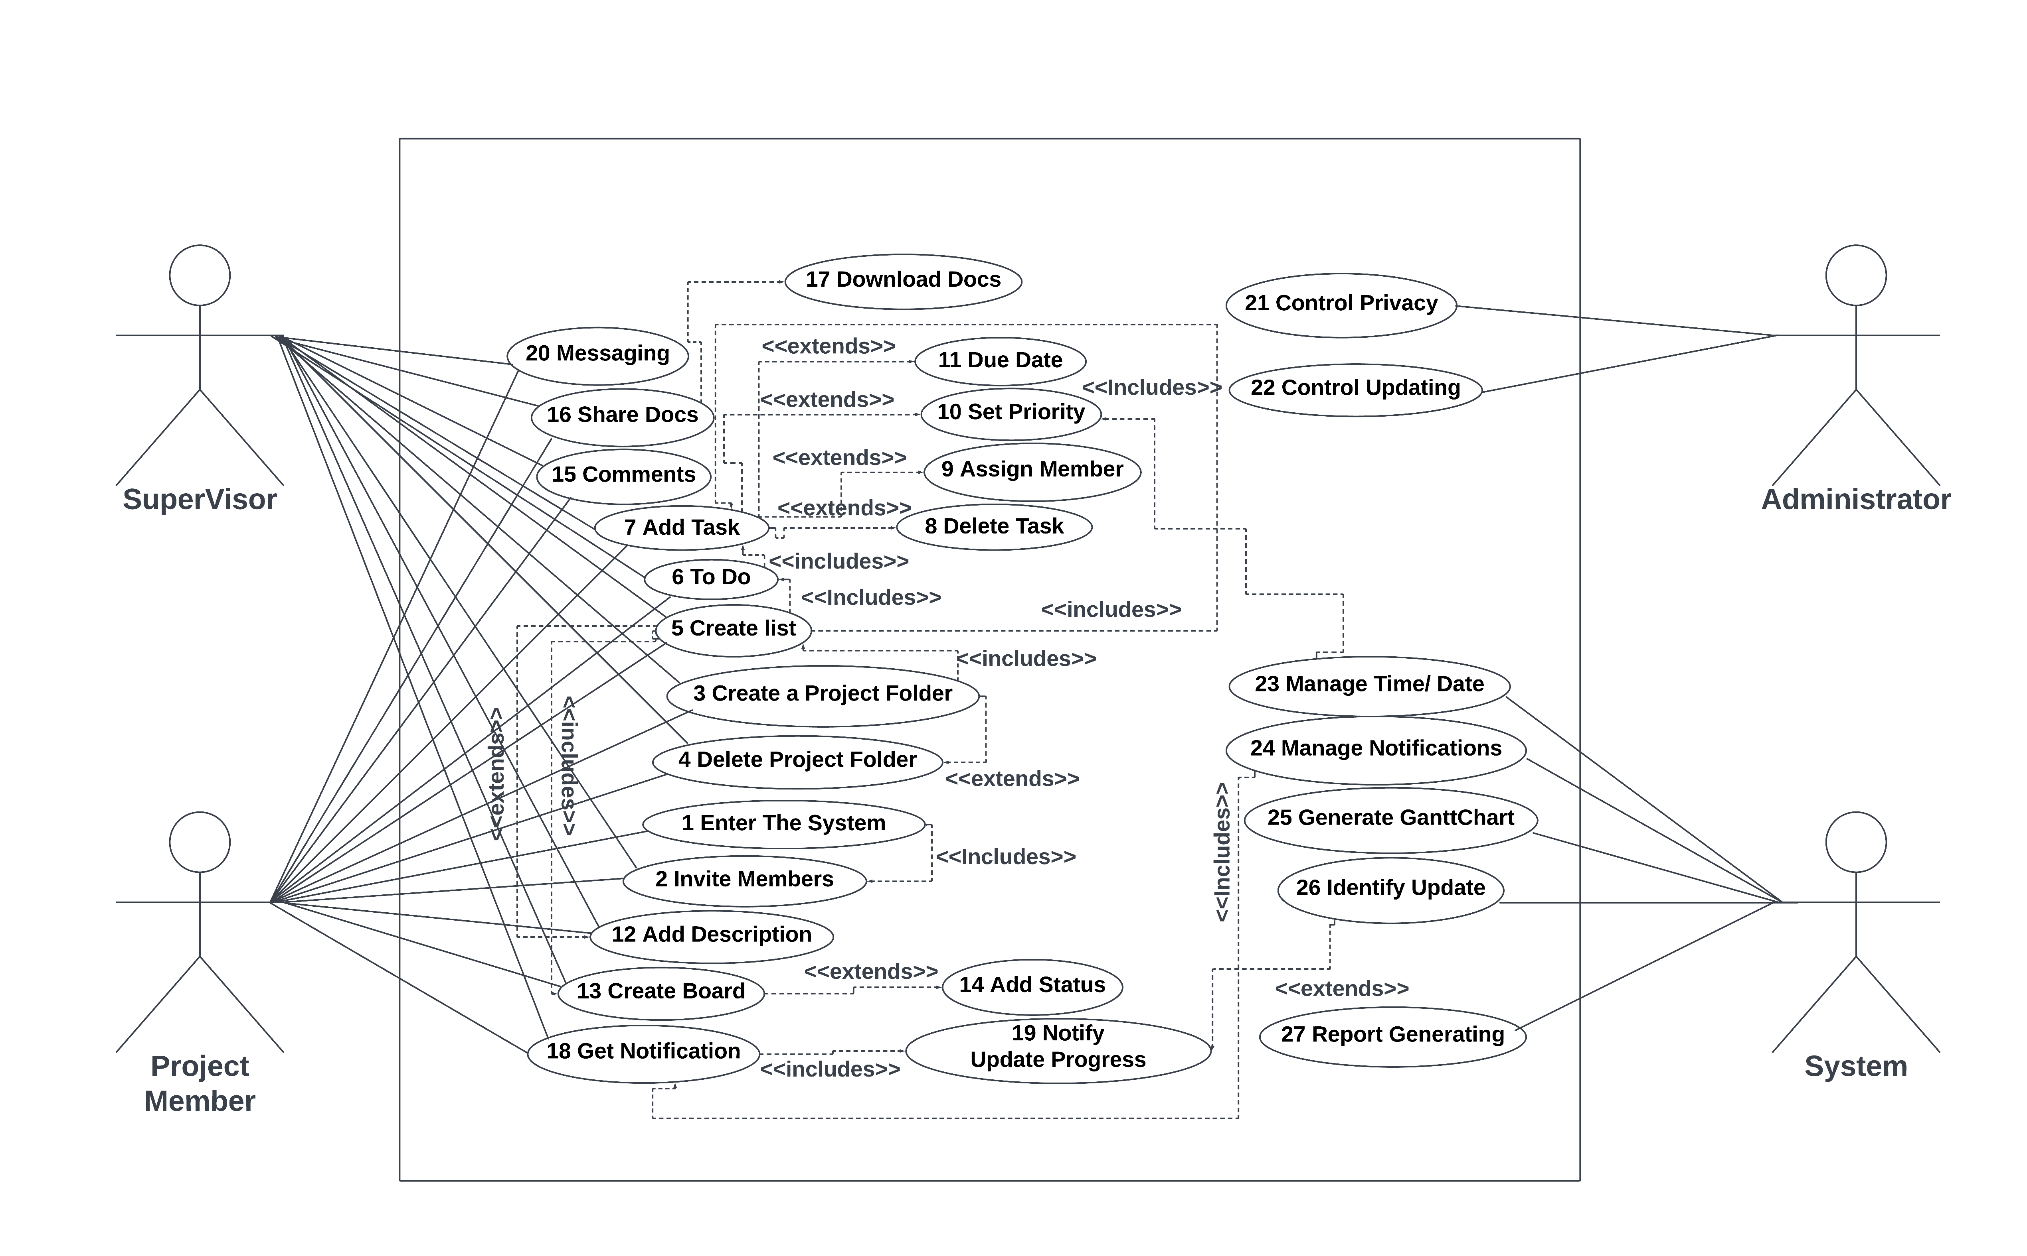
Activity Diagram
07 September, 2023 page 07

Slide 8
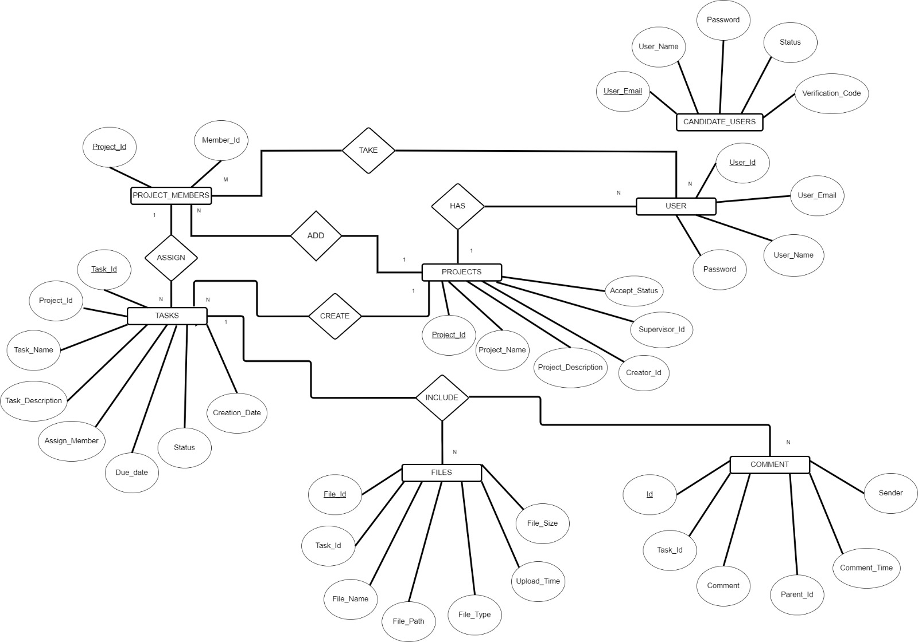
ER Diagram
07 September, 2023 page 08

Slide 9
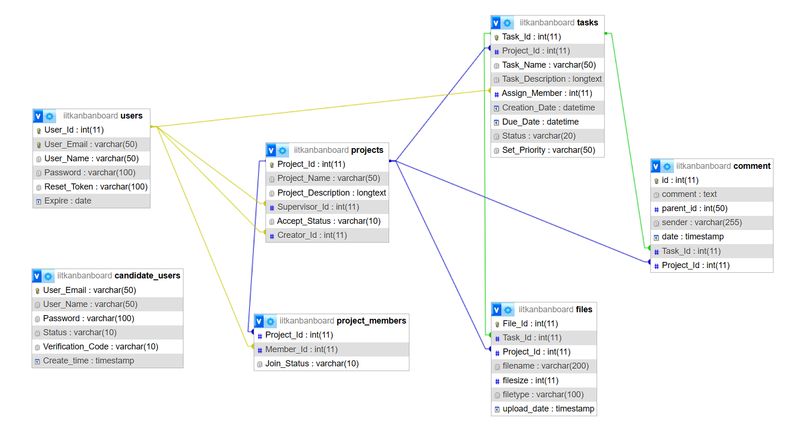
Database Schema
07 September, 2023 page 09

Slide 10

Thank You
07 September, 2023 page 10

